Slide 1
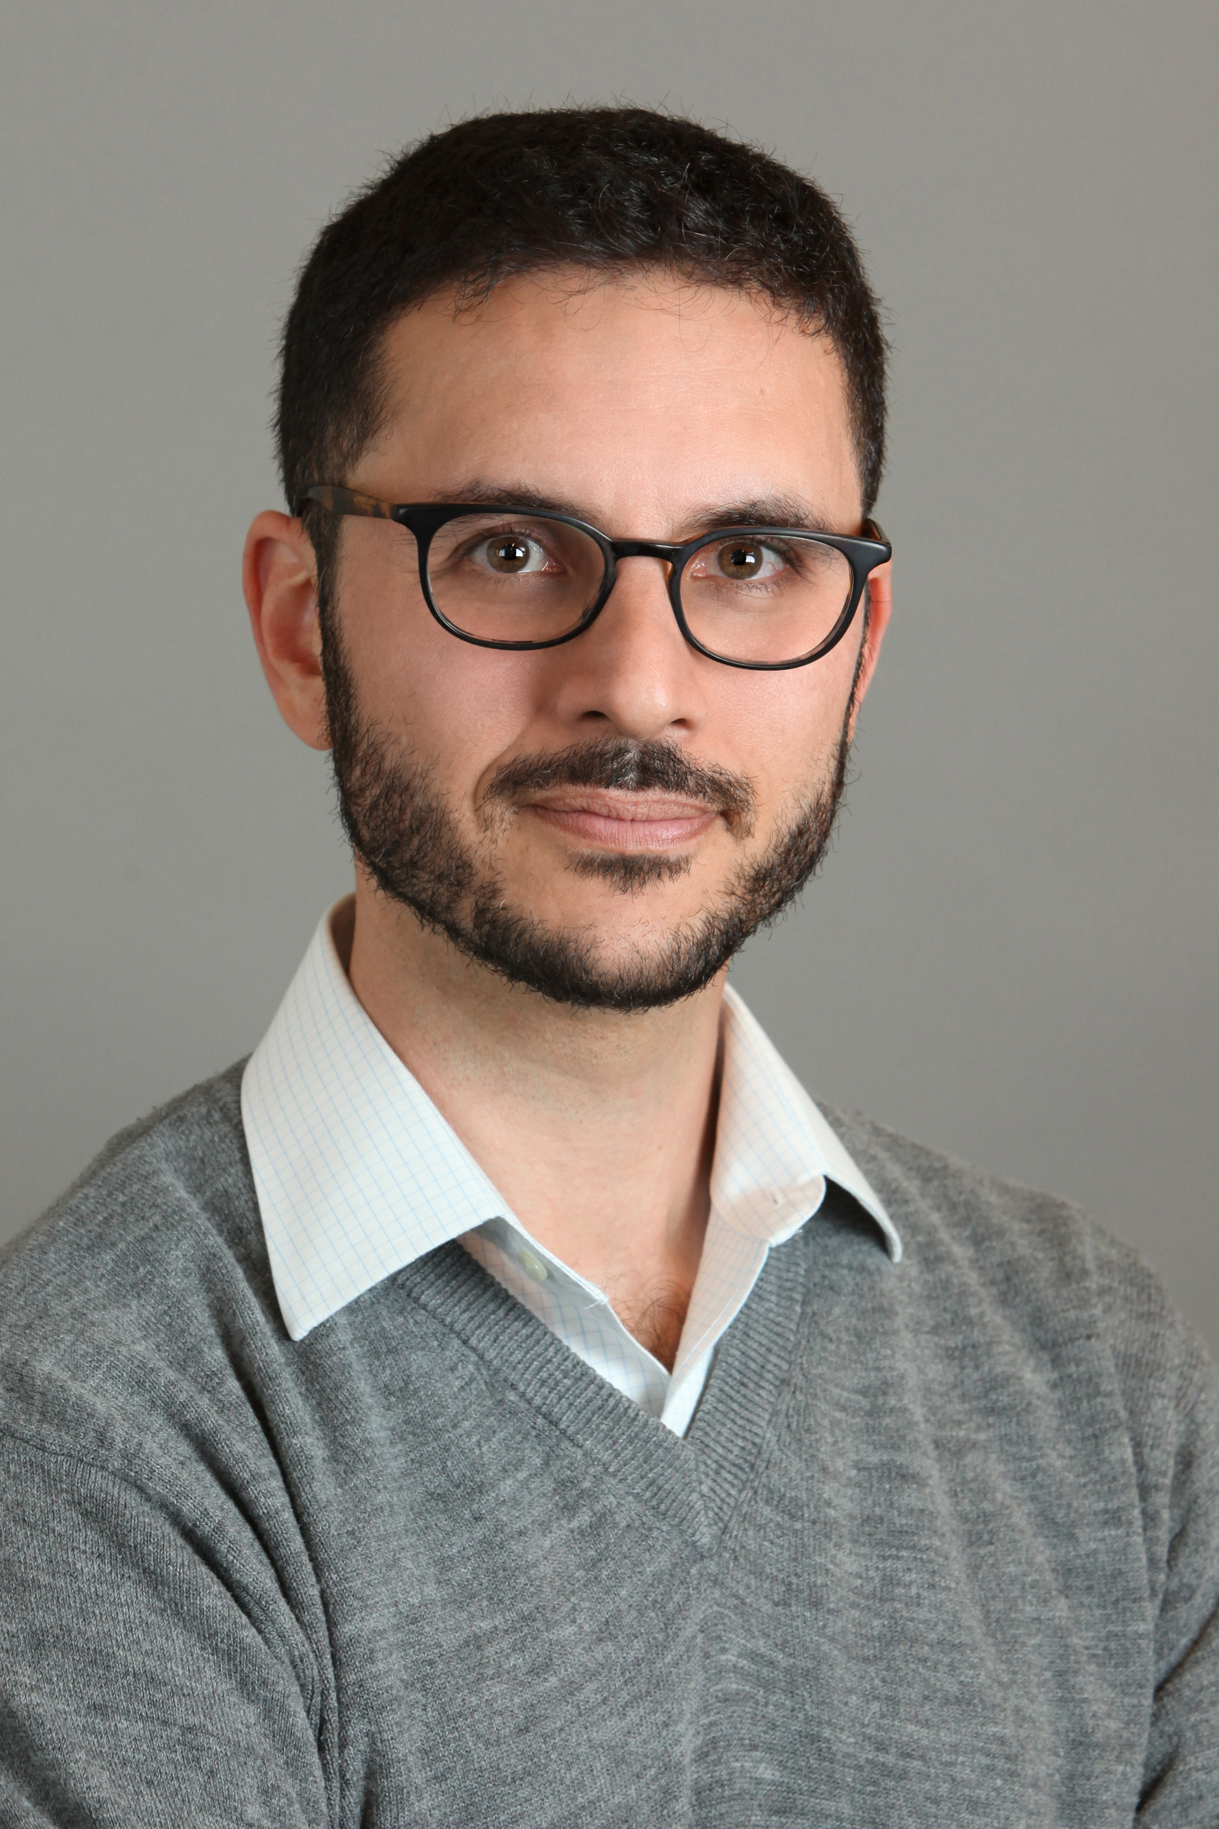
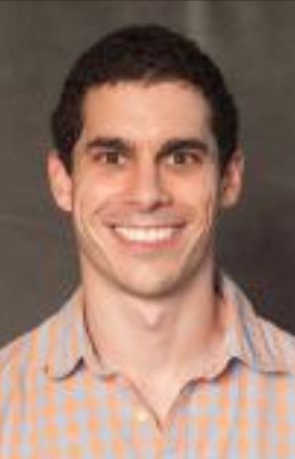
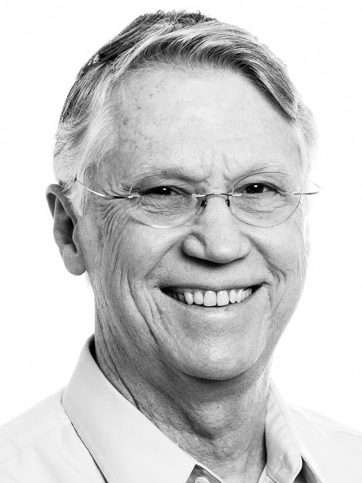

Mergeable Summaries and the DataSketches Library
Edo Liberty,
Director of Research
Head of Amazon AI Labs
Justin Thaler
Assistant Professor
Georgetown University.
Lee Rhodes
Distinguished Architect
Oath, Inc.
Alaxander Saydakov
Senior Software Engineer
Oath, Inc
Kevin Lang
Principal Scientist
Oath, Inc
Jon Malkin
Senior Scientist
Oath, Inc

Slide 2
Single machine data processing
The World
Data
Computation
Result

Slide 3
Distributed storage
The World
Data
Data
Data
Data
Computation
Result

Slide 4
Distributed compute (map/reduce, MPI, …)
The World
Data +
Compute
Data +
Compute
Data +
Compute
Data +
Compute
Data +
Compute
Data +
Compute
Data +
Compute
Data +
Compute
Computation
Result

Slide 5
Distributed model (indexes, databases, Spark…)
The World
Data +
Compute
Data +
Compute
Data +
Compute
Data +
Compute
Data +
Compute
Data +
Compute
Data +
Compute
Data +
Compute
Query
Computation
Computation
Result

Slide 6
The streaming model
The World
Compute
Sketch
Result
Query Algorithm
Result
Query

Slide 7
Mergeable Summaries
The World
Compute + Sketch
Compute + Sketch
Compute + Sketch
Compute + Sketch
Merge+ Sketch
Result
Query Algorithm
Result
Query

Slide 8
Unique Counting with Map Reduce
Data
Joined
Data
Count unique
Data
Joined
Data
Count unique
Sum
Data
Joined
Data
Count unique
Output
Counts
Data
Joined
Data
Count unique
This is a shuffle operation which is very compute and network heavy!

Slide 9
Unique Counting with Mergeable Summaries
Data
Theta
Sketch
Data
Theta
Sketch
Merge
Data
Theta
Sketch
Output
Sketches
Data
Theta
Sketch
No shuffle operation is needed!

Slide 10
Data Mining with Traditional Windowing
Day -4
Data
Day -3 Data
Day -2
Data
Day -1
Data
Day 0
Data
Day -4
Model
Day -3
Model
Day -2
Model
Day -1
Model
Day 0
Model
Every dataset is processed 3 times for a model consisting of 3 days

Slide 11
Data Mining with Mergeable Summaries
Day -4
Data
Day -3 Data
Day -2
Data
Day -1
Data
Day 0
Data
Sketch
Sketch
Sketch
Sketch
Sketch
Day -4
Model
Day -3
Model
Day -2
Model
Day -1
Model
Day 0
Model
Merge
Merge
Merge
Merge
Every dataset is processed once for a model consisting of the entire history

Slide 12
Dynamic Windowing with Mergeable Summaries

Slide 13
OLAP with Mergeable Summaries
“Median latency of
IoT device call in
Westeros January 2018”
“Median latency of
IoT device call in
The North Q1 2018”

Slide 14
IoT and Cloud Monitoring
Logs
Sending all the data
Database/
Analytics Engine

Slide 15
IoT and Cloud Monitoring
Sketch Based
Analytics Engine
Sending only sketches

Slide 16
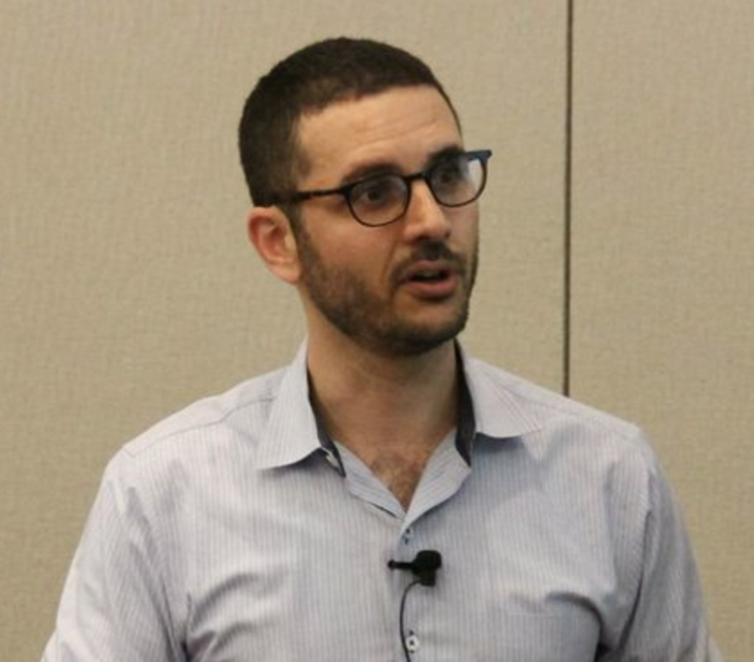
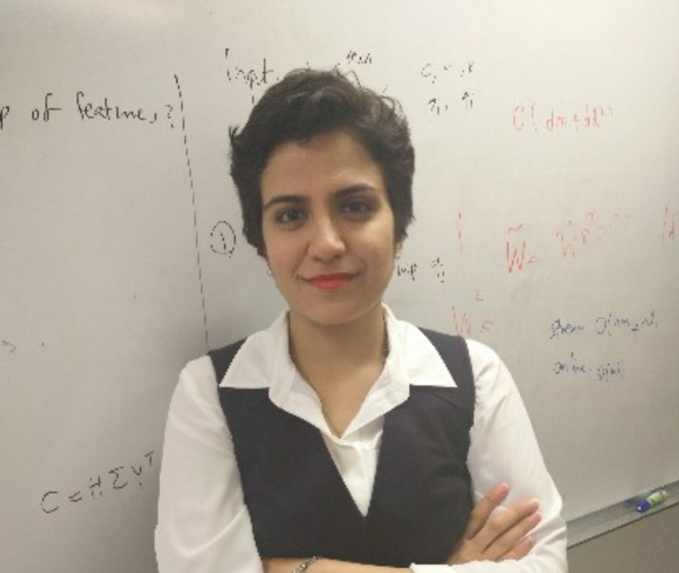
Some Basic Problems are Impossible
1
7
8
1
0
1
7
7
Iterator
Iterator
Sketch
Result

Slide 17
What can we do in this model?
Items
(words, IP-addresses, events, clicks,...)
Counting distinct elements
Item frequencies
Approximate Quantiles
Moment and entropy estimation
Approximate set operations
Sampling
Matrices
(text corpora, recommendations, ...)
Covariance estimation matrix
Low rank approximation
Sparsification
Vectors
(text documents, images, example features,...)
Dimensionality reduction
Clustering (k-means, k-median,…)
Linear Regression
Machine learning (some of it at least)
Density Estimation / Anomaly detection
Graphs*
(social networks, communications, ...)
Connectivity
Cut Sparsification
Weighted Matching

Slide 18
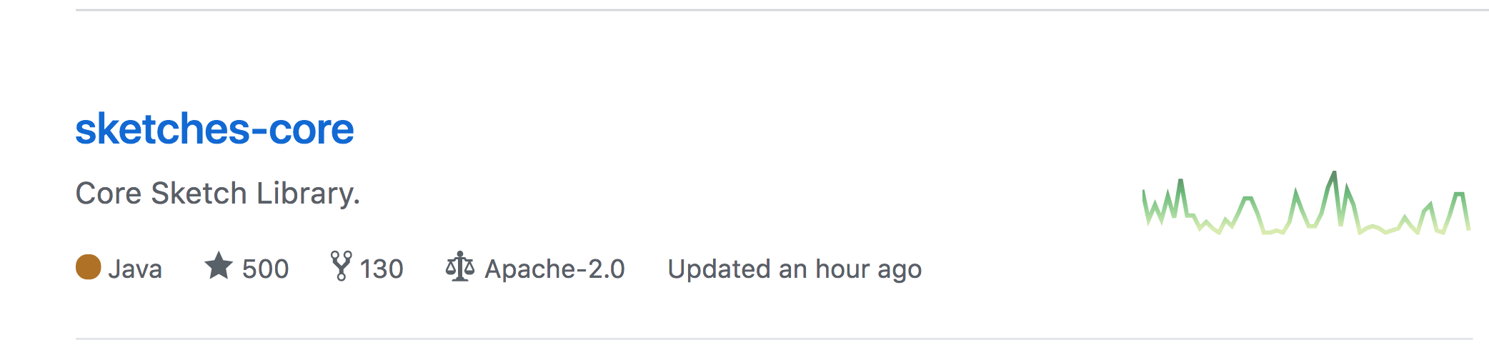
Data Sketches – Open Source Project
🍾
>> brew tap DataSketches/sketches-cmd
>> brew install data-sketches
🍺
L. Rhodes, K. Lang, A. Saydakov, J. Thaler, E. Liberty, and J. Malkin. DataSketches: A Java software library of stochastic streaming algorithms, 2017. https://datasketches.github.io.

Slide 19




Production ready

Slide 20
New Research
[ABL+17] Daniel Anderson, Pryce Bevan, Kevin J. Lang, Edo Liberty, Lee Rhodes, and Justin Thaler.
A high-performance algorithm for identifying frequent items in data streams.
In ACM IMC 2017 (To Appear), 2017. Preliminary version available at https://arxiv.org/abs/1705.07001.
[DLRT16] Anirban Dasgupta, Kevin J. Lang, Lee Rhodes, and Justin Thaler.
A framework for estimating stream expression cardinalities. In *ACM ICDT Proceedings ‘16 *, pages 6:1–6:17, 2016.
[KLL16] Zohar S. Karnin, Kevin J. Lang, and Edo Liberty.
Optimal quantile approximation in streams. In IEEE FOCS Proceedings ‘16, pages 71–78, 2016.
[Lan17] Kevin J Lang. Back to the future: an even more nearly optimal cardinality estimation algorithm.
arXiv preprinthttps://arxiv.org/abs/1708.06839, 2017.
[Lib13] Edo Liberty. Simple and deterministic matrix sketching.
In ACM KDD Proceedings ‘13, pages 581– 588, 2013.
[LMTU16] Edo Liberty, Michael Mitzenmacher, Justin Thaler, and Jonathan Ullman.
Space lower bounds for itemset frequency sketches. In ACM PODS Proceedings ‘16, pages 441–454, 2016.
[MST12] Michael Mitzenmacher, Thomas Steinke, and Justin Thaler.
Hierarchical heavy hitters with the space saving algorithm. In SIAM ALENEX Proceedings ‘12, pages 160–174, 2012.

Slide 21
In this presentation
Items
(words, IP-addresses, events, clicks,...)
Counting distinct elements
Item frequencies
Approximate Quantiles
Moment and entropy estimation
Approximate set operations
Sampling
Matrices
(text corpora, recommendations, ...)
Covariance estimation matrix
Low rank approximation
Sparsification
Vectors
(text documents, images, example features,...)
Dimensionality reduction
Clustering (k-means, k-median,…)
Linear Regression
Machine learning (some of it at least)
Density Estimation / Anomaly detection
Graphs*
(social networks, communications, ...)
Connectivity
Cut Sparsification
Weighted Matching

Slide 22
Counting Distinct Elements
N. Alon, Y. Matias, and M. Szegedy. The space complexity of approximating the frequency moments
Z. Bar-Yossef, T. Jayram, R. Kumar, D. Sivakumar, and L. Trevisan. Counting distinct elements in a data stream
E. Cohen. All-distances sketches, revisited: HIP estimators for massive graphs analysis
E. Cohen and H. Kaplan. Summarizing data using bottom-k sketches
G. Cormode. Sketch techniques for massive data
P. Flajolet and G. Nigel Martin. Probabilistic counting algorithms for data base applications
D. M. Kane, J. Nelson, and D. P. Woodruff. An optimal algorithm for the distinct elements problem
M. Thorup. Bottom-k and priority sampling, set similarity and subset sums with minimal independence
A. Dasgupta, K Lang, L. Rhodes, J. Thaler, A Framework for Estimating Stream Expression Cardinalities

Slide 23
Problem Definition
Approximate the number of
distinct items in the stream
# of unique IPs are important statistics of networks
# of different customers using web services
# of unique keys in a database join table
...

Slide 24
General Hashing Idea
Map all entries to the interval (0,1) using a hash function
Keep only values smaller than some threshold .
From we can approximate the number of unique items.

Slide 25
Our results
Generalize a family of algorithms (Adaptive sampling, KMV)
New Variance bounds for all such algorithms
New tradeoffs between accuracy, space, and update time (alpha alg’)
Very careful implementation

Slide 26
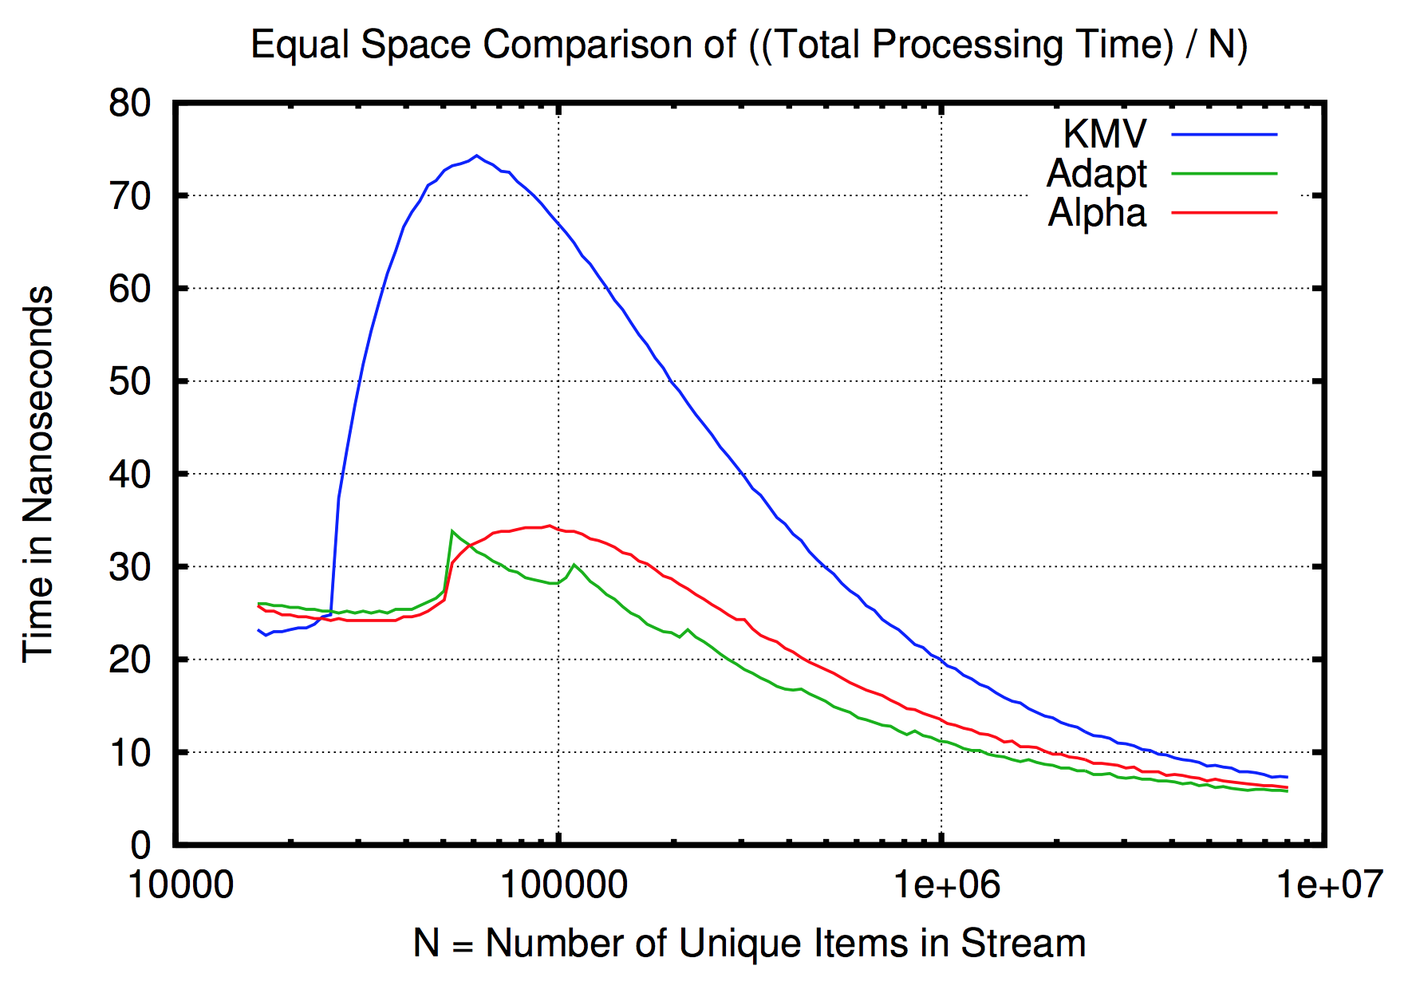
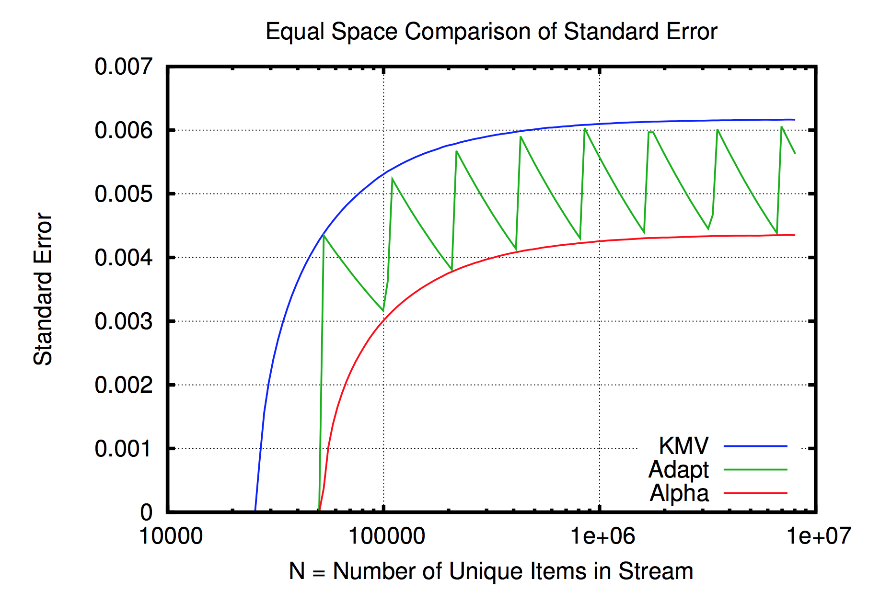
Experimental Results

Slide 27
Quick Demo
Counting Distinct Elements

Slide 28
Assume you need to estimate the number of unique numbers in a file
>>head data.csv
0
1
0
3
0
2
3
7
3
2
In this file, row i tasks integer value from [0,i] uniformly at random.

Slide 29
Some stats: there are 10,000,000 such numbers in this ~76Mb file.
>>time wc -lc data.csv
10000000 76046666 data.csv
real 0m0.101s
user 0m0.072s
sys 0m0.021s
Reading the file take ~1/10 seconds. We don’t foresee IO being an issue.

Slide 30
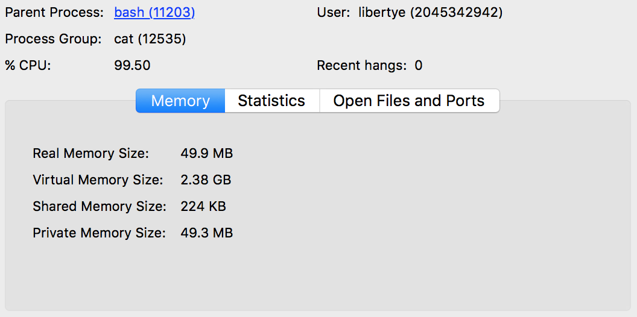
To count the number of distinct items you might try this:
>>sort data.csv | uniq | wc -l
However, it is faster to “uniqify” while sorting.
>>sort data.csv -u | wc -l
>>time sort data.csv -u | wc -l
5001233
real 2m37.071s
user 2m36.587s
sys 0m0.376s

Slide 31
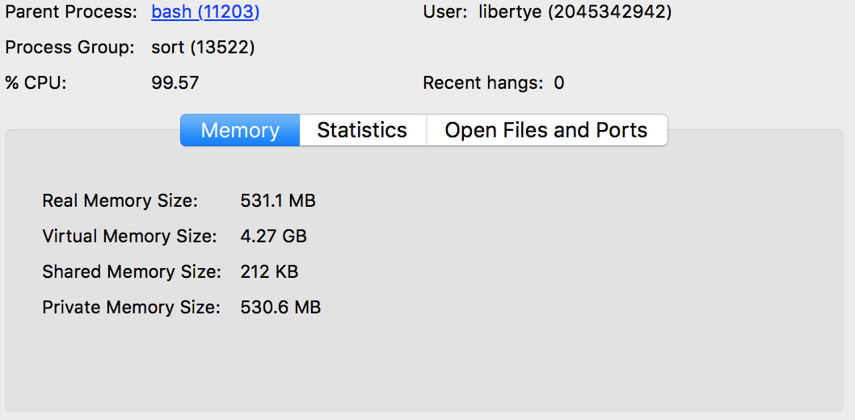
Still, most of the time is spent on comparing strings....
>>sort data.csv -u -n -S 100% | wc -l
This is much better!
>>time sort data.csv -u -n | wc -l
5001233
real 0m11.809s
user 0m11.587s
sys 0m0.228s

Slide 32
This is the way to do this with the sketching library
>>cat data.csv | ds theta
>>time cat data.csv | ds theta
4835874.828244 4974249.044005 5116568.411181
real 0m1.539s
user 0m2.184s
sys 0m0.310s
Too fast for system monitor UI...
It uses ~ 32k of memory!

Slide 33
Weighted Item frequencies
Space-optimal heavy hitters with strong error bounds. ] R. Berinde, P. Indyk, G. Cormode, and M. J. Strauss
An optimal algorithm for `1-heavy hitters in insertion streams and related problems A. Bhattacharyya, P. Dey, and D. P. Woodruff
Finding frequent items in data streams M. Charikar, K. Chen, and M. Farach-Colton
Methods for finding frequent items in data streams G. Cormode and M. Hadjieleftheriou
An improved data stream summary: The count-min sketch and its applications. G. Cormode and S. Muthukrishnan.
Approximate frequency counts over data streams G. S. Manku and R. Motwani.
Efficient computation of frequent and top-k elements in data streams A. Metwally, D. Agrawal, and A. El Abbadi.
Finding repeated elements J. Misra and D. Gries.
A High-Performance Algorithm for Identifying Frequent Items in Data Streams
Daniel Anderson Pryce Bevin, Kevin Lang, Edo Liberty, Lee Rhodes, Justin Thaler

Slide 34
Problem Definition

Slide 35
Our Contributions
Improved streaming algorithm for weighted updates
Improved merging procedure
Improved Estimator
Careful implementation

Slide 41
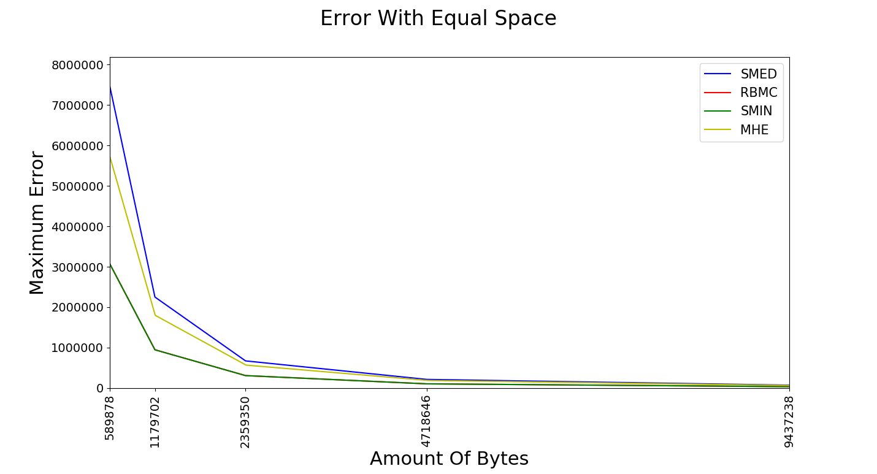
Comparable Error

Slide 42
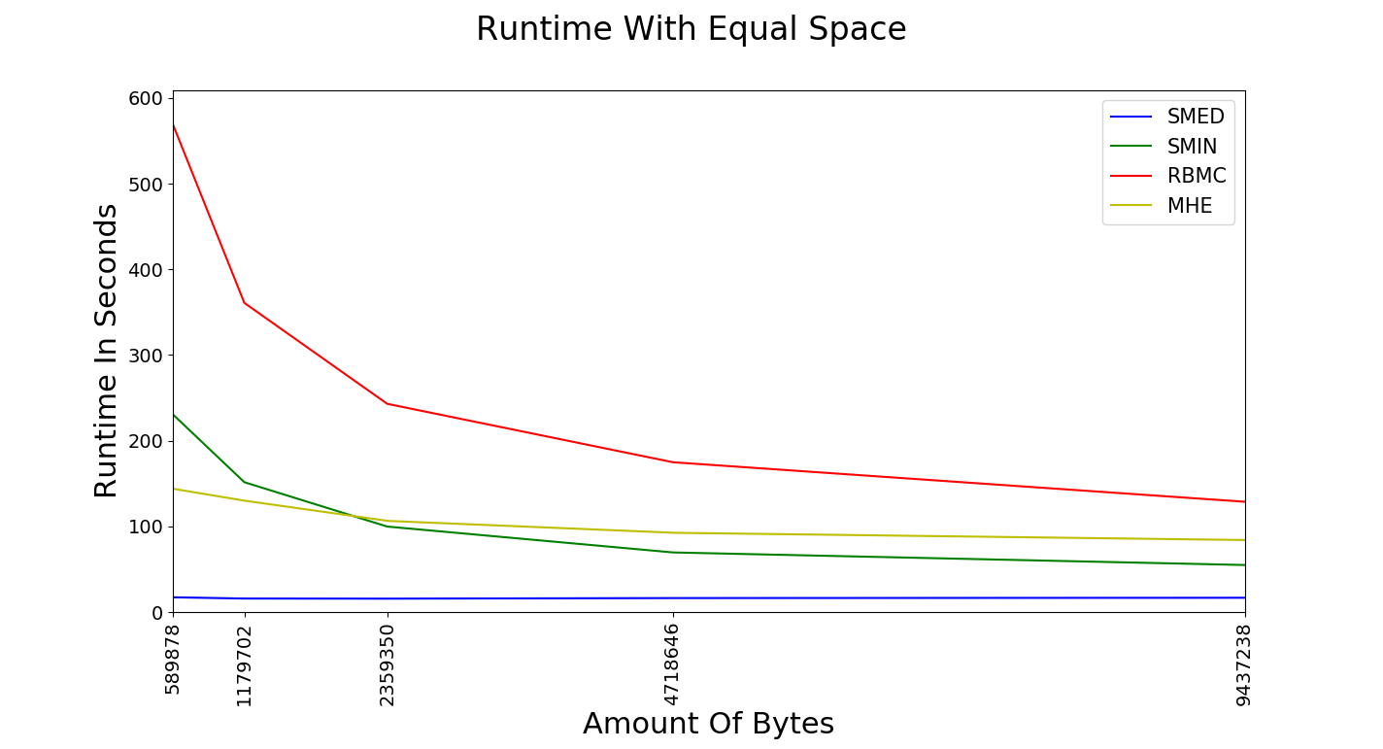
Significantly Faster Updates

Slide 43
Weighted Item Frequencies Application

Slide 44
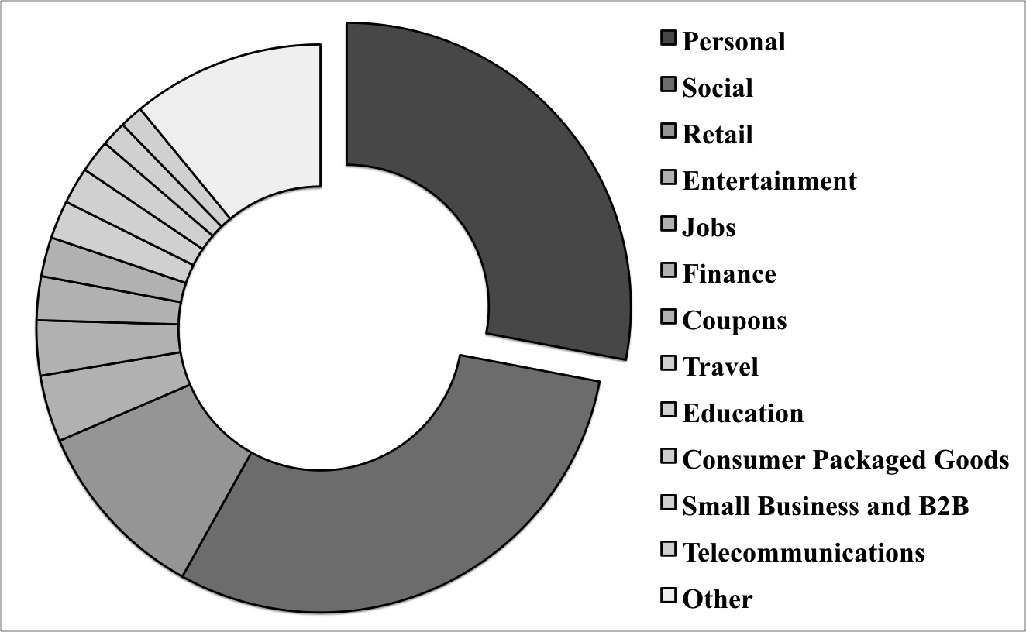


Threading Machine Generated Email
Ailon, Karnin, Maarek, Liberty,
Threading Machine Generated Email, WSDM 2013

Slide 45
Threading Machine Generated Email
If b should be threaded with a then the lift should be large
Alas, computing all pair conditional probability is impossible!
This is possible with weighted frequency sketching!

Slide 46
Threading Machine Generated Email

Slide 47
Threading Machine Generated Email

Slide 48
Streaming quantiles
Manku, Rajagopalan, Lindsay. Random sampling techniques for space efficient
online computation of order statistics of large datasets.
Munro, Paterson. Selection and sorting with limited storage.
Greenwald, Khanna. Space-efficient online computation of quantile summaries.
Wang, Luo, Yi, Cormode. Quantiles over data streams: An experimental study.
Greenwald, Khanna. Quantiles and equidepth histograms over streams.
Agarwal, Cormode, Huang, Phillips, Wei, Yi. Mergeable summaries.
Felber, Ostrovsky. A randomized online quantile summary in O((1/ε) log(1/ε)) words.
Lang, Karnin, Liberty, Optimal Quantile Approximation in Streams.
Ivking, Lang, Karnin, Liberty, Braverman, Streaming quantiles algorithms with small space and update time

Slide 49
Problem Definition
Sketch the stream to estimate

Slide 50
Our result
Algorithm | Simple? | Mergeable | Space Complexity
Uniform sampling
Greenwald Khanna (GK)
Felber-Ostrovsky
Manku-Rajagopalan-Lindsay (MRL)
Agarwal, Cormode, Huang, Phillips, Wei, Yi
Karnin, Lang, Liberty
Karnin, Lang, Liberty
Karnin, Lang, Liberty
Still open...
Implemented
Implemented
Space Optimal

Slide 51
The basic buffer idea
Buffer of size k
5
1
4
7
0
3

Slide 52
The basic buffer idea
Stores k stream entries
3
0
7
4
1
5

Slide 53
The basic buffer idea
The buffer sorts k stream entries
7
5
4
3
1
0

Slide 54
The basic buffer idea
Deletes every other item
7
5
4
3
1
0

Slide 55
The basic buffer idea
And outputs the rest
with double the weight
5
3
0

Slide 56
The basic buffer idea
0
1
3
4
5
7
0
3
5
1
4
7

Slide 57
The basic buffer idea
Repeat time until the end of the stream
5
0
5
1
0
3

Slide 58
Manku-Rajagopalan-Lindsay (MRL) sketch
Buffers of size
5
1
0
3

Slide 59
Manku-Rajagopalan-Lindsay (MRL) sketch
If we set
We get
And we maintain only items from the stream!

Slide 60
Greenwald-Khanna (GK) sketch
Uses a completely different construction
It gets
And maintains only items from the stream!

Slide 61
Agarwal, Cormode, Huang, Phillips, Wei, Yi (1)
Buffers of size
start sampling
after items
5
1
0
3
Reduces space usage to items from the stream.

Slide 62
Agarwal, Cormode, Huang, Phillips, Wei, Yi (2)
5
7
5
is a random
variable now and
7
Reduces space usage to items from the stream.

Slide 63
Lang, Karnin, Liberty (1)
Exponentially shrinking buffers
5
1
0
3
Reduces space usage to items from the stream.

Slide 64
Lang, Karnin, Liberty (2)
Exponentially decreasing buffer sizes
GK Sketch
5
1
0
3
Which is Optimal!
Reduces space usage to items from the stream.

Slide 65
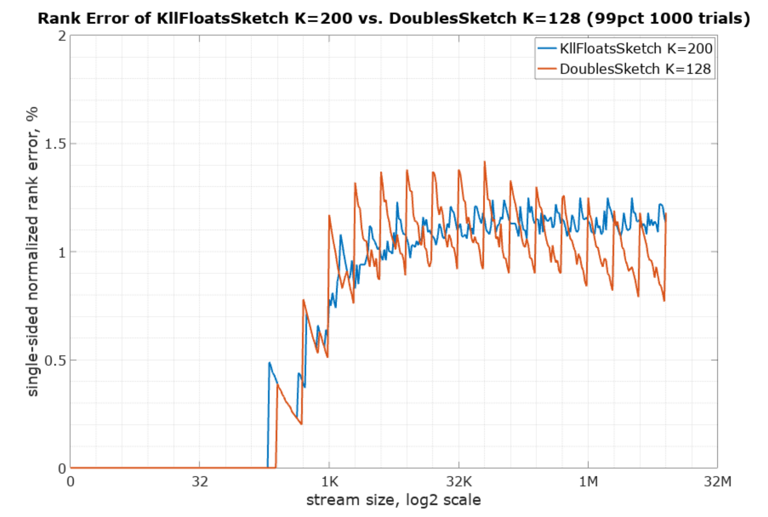
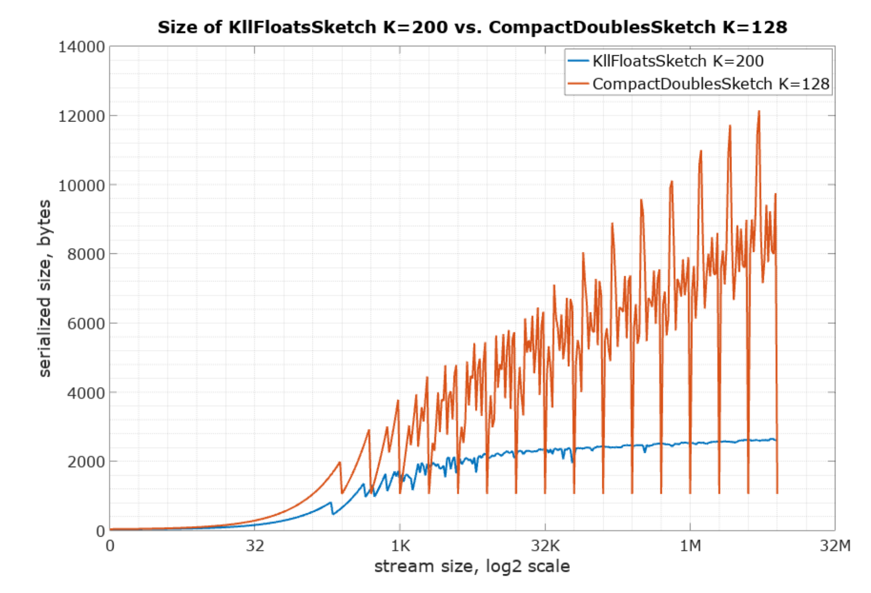
Experimental Results
More experiments:
https://datasketches.github.io/docs/Quantiles/KLLSketch.html
https://datasketches.github.io/docs/Quantiles/KllSketchVsTDigest.html

Slide 66
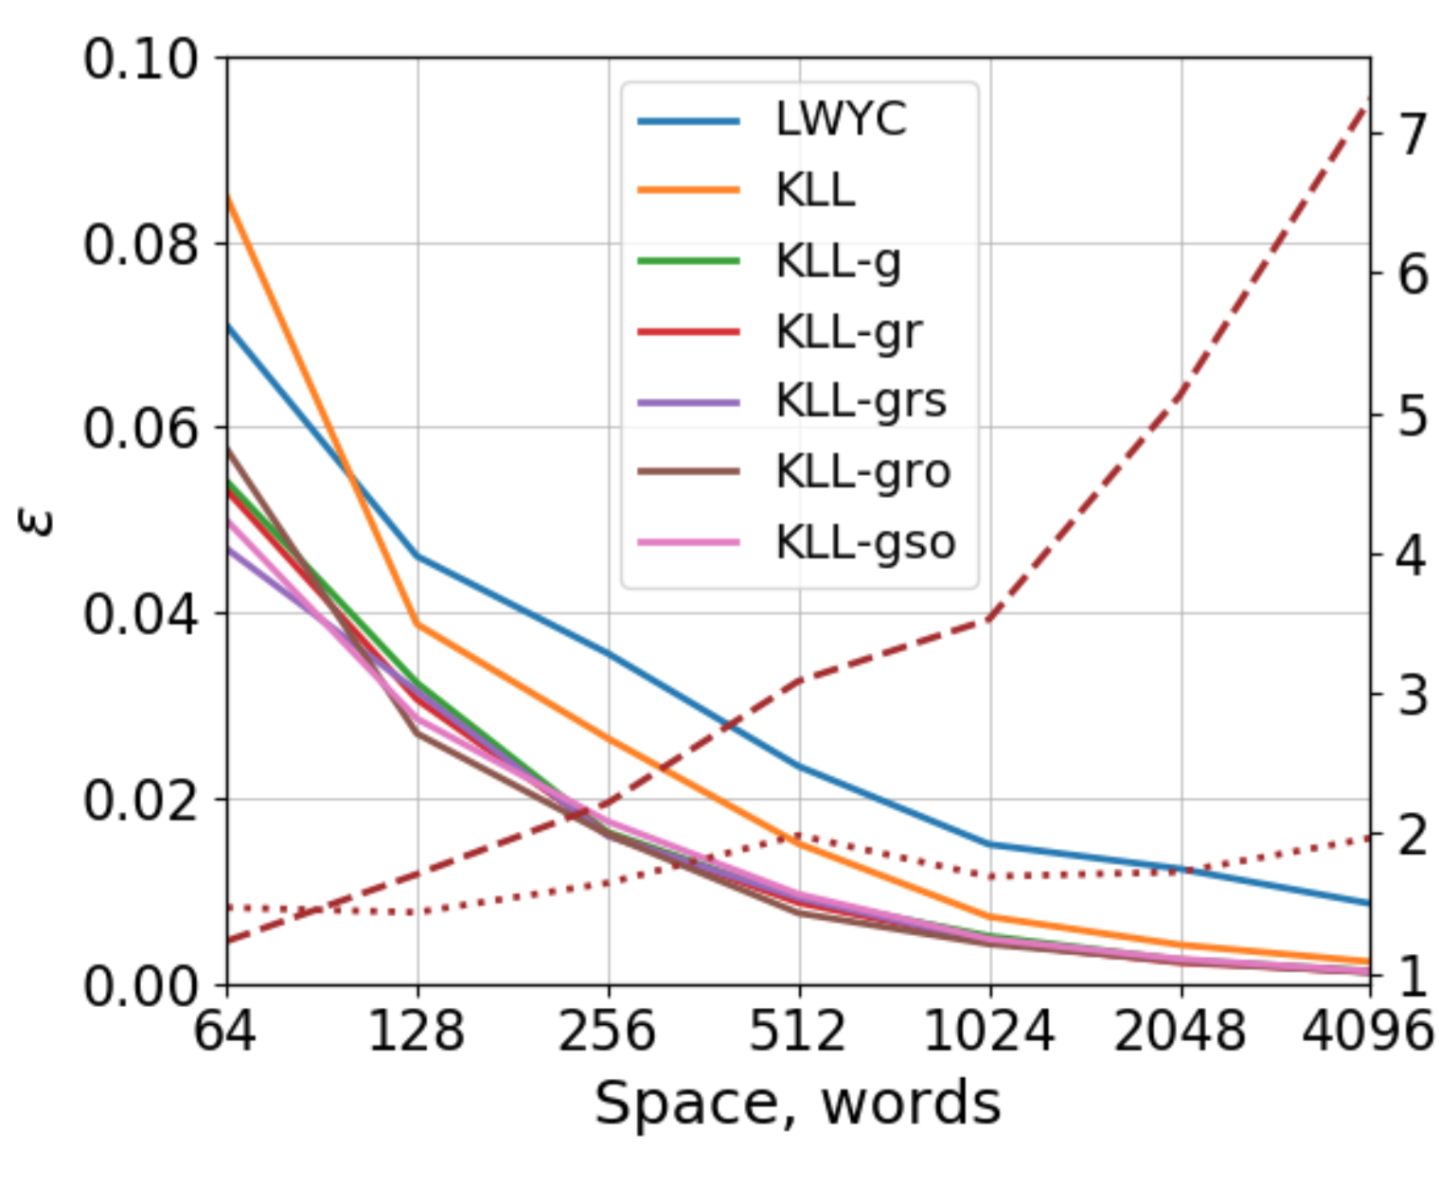
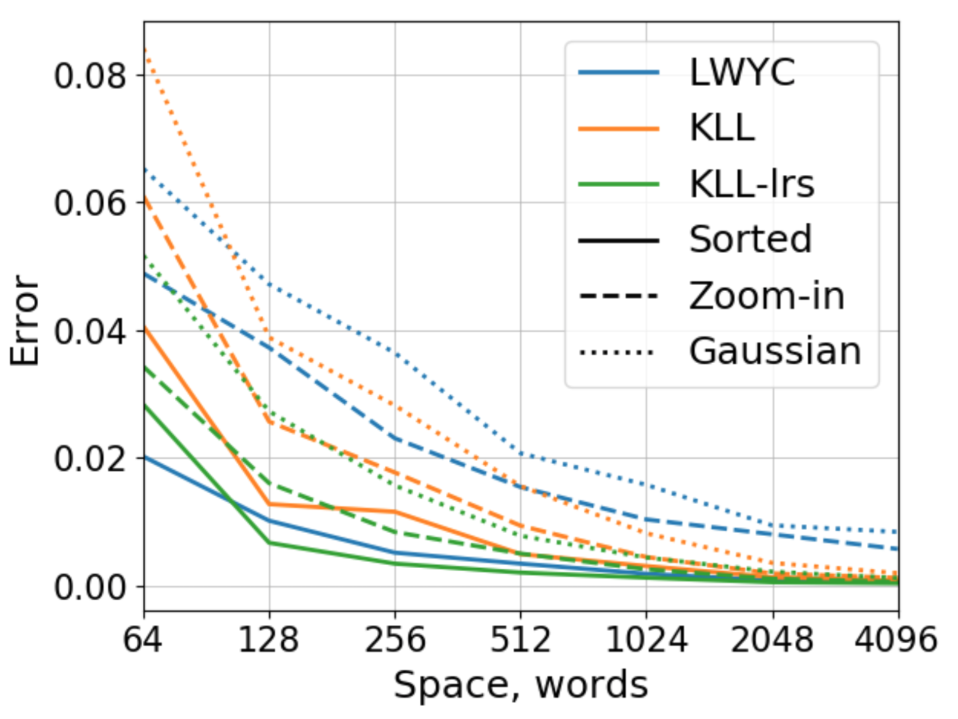
Even Newer Experimental Results
Ivking, Lang, Karnin, Liberty, Braverman, Streaming quantiles algorithms with small space and update time

Slide 67
What else can we do in this model?
Items
(words, IP-addresses, events, clicks,...)
Counting distinct elements
Item frequencies
Approximate Quantiles
Moment and entropy estimation
Approximate set operations
Sampling
Matrices
(text corpora, recommendations, ...)
Covariance estimation matrix
Low rank approximation
Sparsification
Vectors
(text documents, images, example features,...)
Dimensionality reduction
Clustering (k-means, k-median,…)
Linear Regression
Machine learning (some of it at least)
Density Estimation / Anomaly detection
Graphs*
(social networks, communications, ...)
Connectivity
Cut Sparsification
Weighted Matching

Slide 68
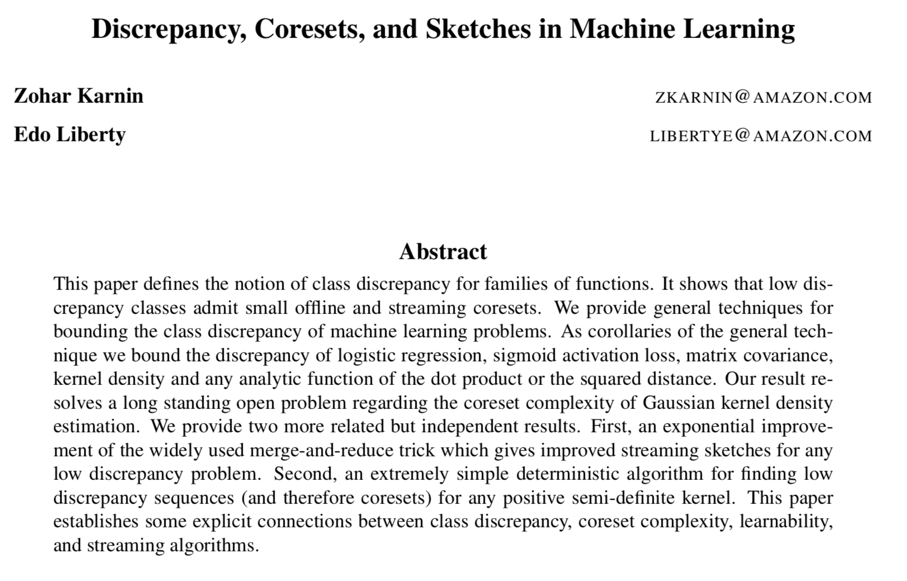

Slide 69
Original Data
Coreset

Slide 72
ML and Coresets are intimately connected
Rademacher Complexity
Sample Complexity
Model Generalization
Class Discrepancy
Coreset Complexity
Sketch Gentralization

Slide 73
Warmup exercise…
Does not depend on n
That’s encouraging.....

Slide 74
Universal Vector Balancing Lemma
Lemma [Karnin, Liberty, 2019]: For any set of unit vectors there
exist signs such that for all k simultaneously
Still does not depend on n !

Slide 75
Results
Resolves the open problem
See Philips an Tai 2018
Sigmoid Activation Regression, Logistic Regression
Covariance approximation, Graph Laplacians Quadratic forms
Gaussian Kernel Density estimation
All have the above have Class Discrepancy of
coresets of size
Streaming Coresets of size
Randomized Streaming Coresets of size

Slide 76
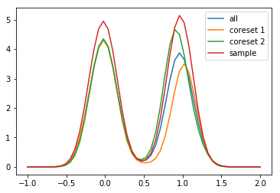
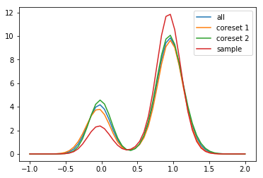
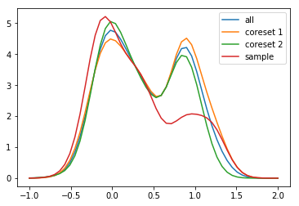
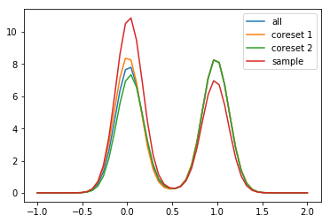
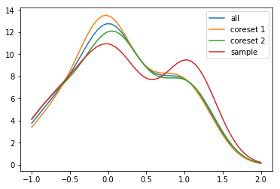
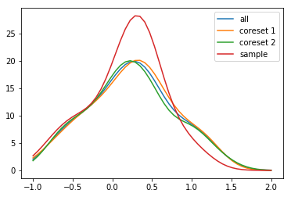
Results for density estimation

Slide 77
There is still a lot of work…
Classification with 0-1 loss
Exponential Kernel Density

Slide 78
Pankaj K Agarwal, Sariel Har-Peled, and Kasturi R Varadarajan. Geometric approximation via coresets. Combinatorial and computational geometry, 52:1–30, 2005. Jeff M Phillips. Small and stable descriptors of distributions for geometric statistical problems. PhD thesis, 2009. Jeff M. Phillips and Wai Ming Tai. Improved coresets for kernel density estimates. Proceedings of the Twenty-Ninth Annual ACM-SIAM Symposium on Dis- crete Algorithms, SODA 2018 Dan Feldman and Michael Langberg. A unified framework for approximating and clustering data. 2011 Jeff M. Phillips and Wai Ming Tai. Near-optimal coresets of kernel density estimates Elad Tolochinsky and Dan Feldman. Coresets for monotonic functions with applications to deep learning. Sariel Har-Peled, Dan Roth, and Dav Zimak. Maximum margin coresets for active and noise tolerant learning. IJCAI 2007 Sariel Har-Peled and Akash Kushal. Smaller coresets for k-median and k-means clustering. The21st ACM Symposium on Computational Geometry, Pisa, Italy, June 6-8, 2005 Gurmeet Singh Manku, Sridhar Rajagopalan, and Bruce G. Lindsay. Random sampling techniques for space efficient online computation of order statistics of large datasets. Alexander Munteanu, Chris Schwiegelshohn, Christian Sohler, and David P. Woodruff. On coresets for logistic regression. Zohar S. Karnin, Kevin J. Lang, and Edo Liberty. Optimal quantile approximation in streams. IEEE 57th Annual Symposium on Foundations of Computer Science, FOCS 2016 Peter L. Bartlett and Shahar Mendelson. Rademacher and gaussian complexities: Risk bounds and structural results. J. Mach. Learn. Res., 3:463–482, March 2003 Olivier Bachem, Mario Lucic, and Andreas Krause. Practical coreset constructions for machine learning Wojciech Banaszczyk. Balancing vectors and gaussian measures of n-dimensional convex bodies. Random Struct. Algorithms, 12(4):351–360, July 1998
</slides>

